Slide 1

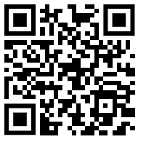
Year 11
ACE your exams evening
Tuesday 26th March 2025
Please scan the QR code to sign in
Scan me!

Slide 2
Key Staff supporting Year 11
Mr Hall – Head of Year 11
Miss Clements – Deputy Head & DSL
Mr Staples – KS4 Raising Standards Lead
Mrs Hayward – Guidance Manager
Miss Baillie – Assistant HOY
The Year 11 Tutor Team
Subject Leads/Teachers
Careers team – Mrs Anderson & Mrs Mays

Slide 3
Key Dates
Friday 4th April | Year group trip to Chessington (TBC)
Tues 22nd & Wed 23rd April | Year 11 MFL (Languages) Speaking & Listening exams
Monday 12th May –Thurs 19th June | Written GCSE exams period
Friday 20th June | Year 11 leavers assembly (pm)
Friday 27th June | Year 11 leavers prom

Slide 4
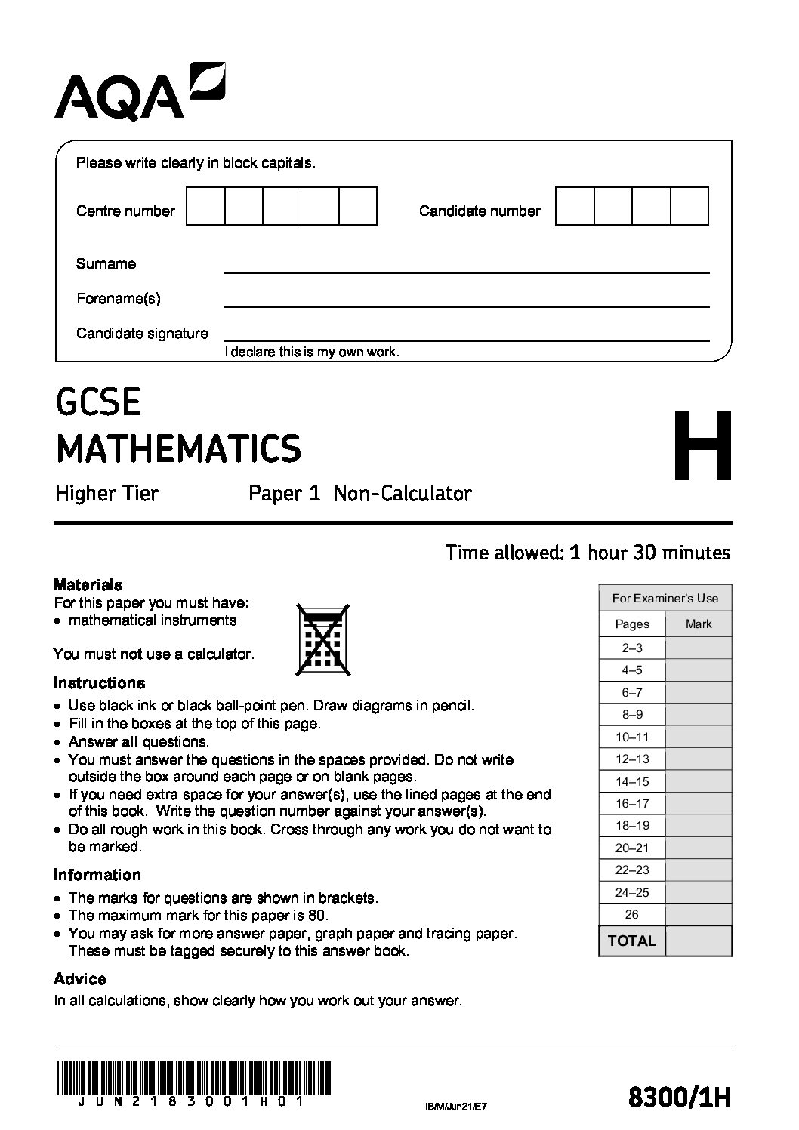
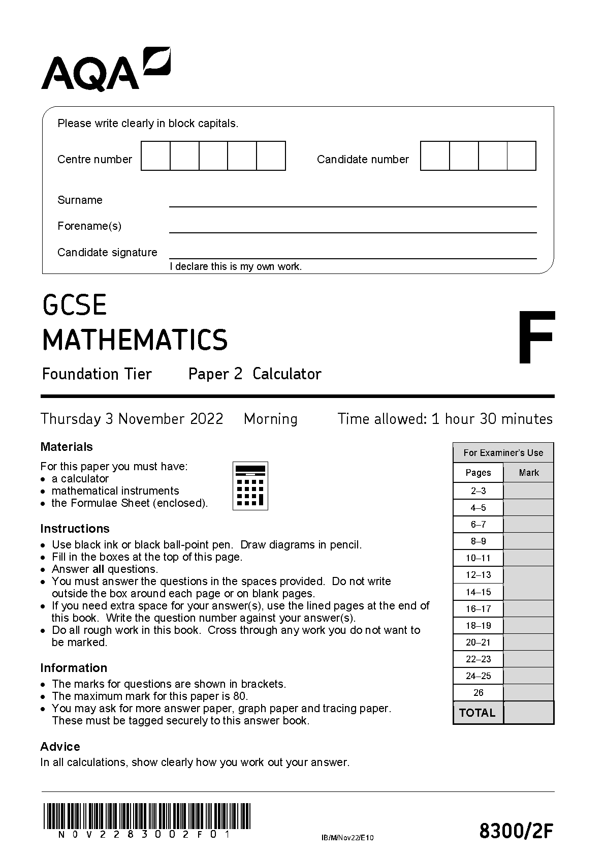

Maths paper break down
Students have their most recent mock grade.
We expect students to go up roughly 1/3 of a grade from this point with booklet revision.

Slide 5
Estimated grade boundaries (per paper)
4 - 59
5 - 69
6 - 48
7 - 61
8 - 69
9 - 77

Slide 6
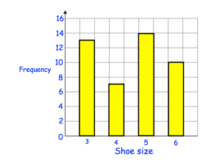
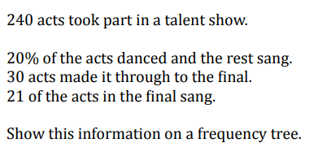
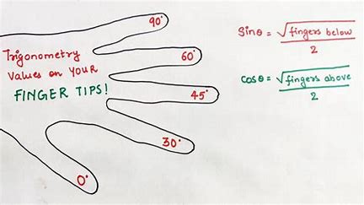
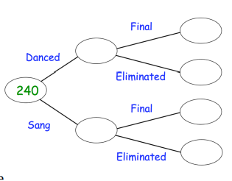
FOUNDATION
HIGHER
What shoe size is the
mode?
Work out the percentage increase from 30 to 150.
What is the exact value of cos 60?

Slide 7
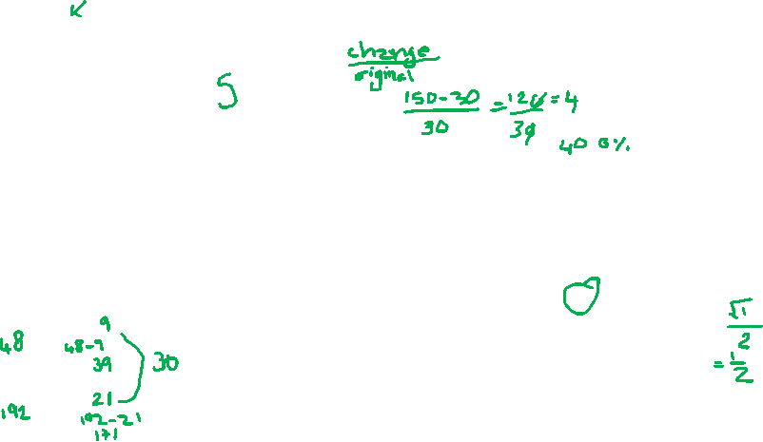
FOUNDATION
HIGHER
What shoe size is the
mode?
Work out the percentage increase from 30 to 150.
What is the exact value of cos 60?

Slide 8
Key things to remember:
Booklets aren’t a test
The score is an effort score
When you find something you don’t know, do something about it!
You need to do further practise and retrieval practise to actually make a difference!

Slide 9
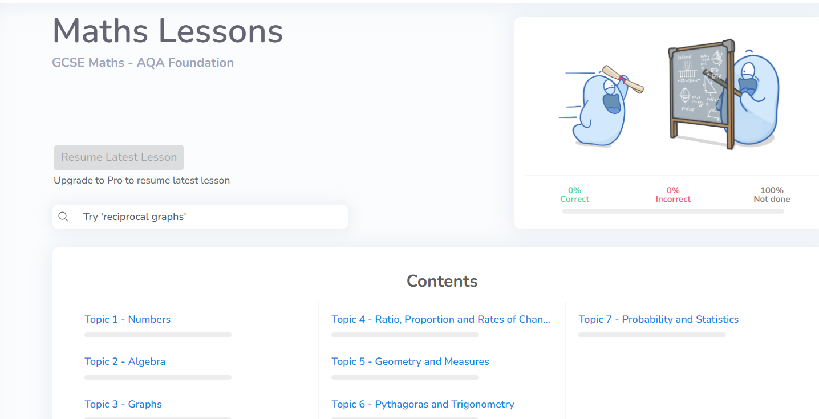
Cognito:

Slide 10
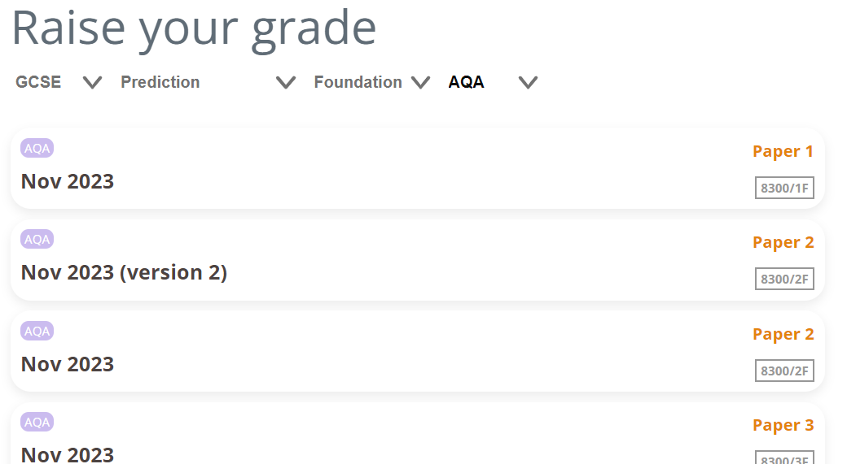
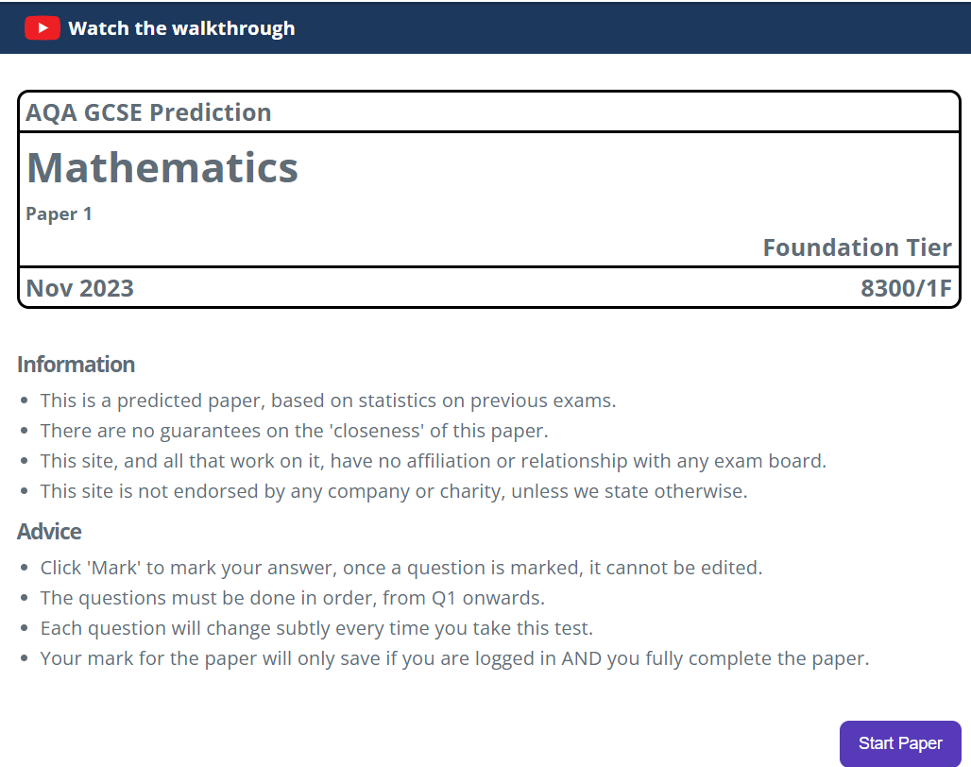
Onmaths:

Slide 11
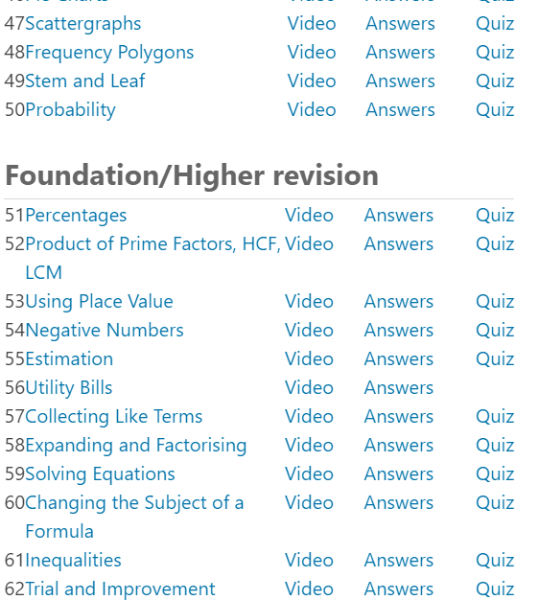
Mathedup:

Slide 12
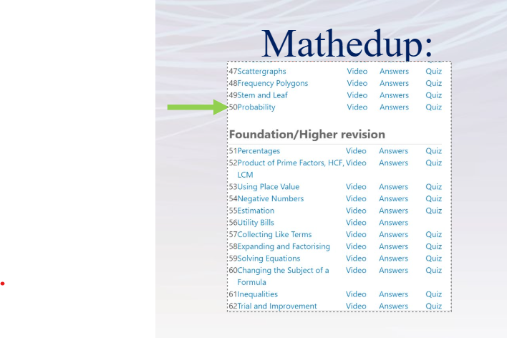
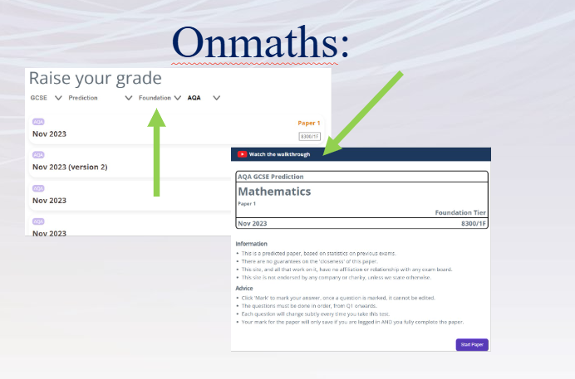
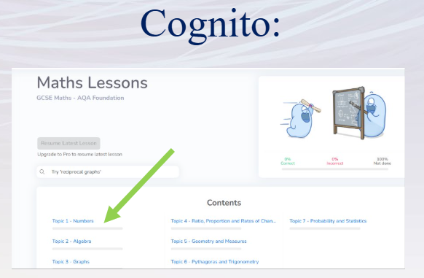

Slide 13

Please note:
Past paper booklets start next week and if students would like to write in theirs we have asked for a £5 contribution towards the cost.

Slide 14

What can we do to help?
Get students to show you their booklets. Ask about their scores. Ask them to explain questions to you that they didn’t know first time.
Remind them to practice the topics some more and of the resources available
Get them to come to period 6 on a Thursday for extra help
Make sure they have their own calculator that they are using
Be there when they get stuck to talk them through the problem. This could be actually helping them with the Maths but it is more important that you are there as an emotional support. Remind them to bring that question in and ask for help and then get them to explain it to you when they come back home.
Cookies.

Slide 15



Slide 16
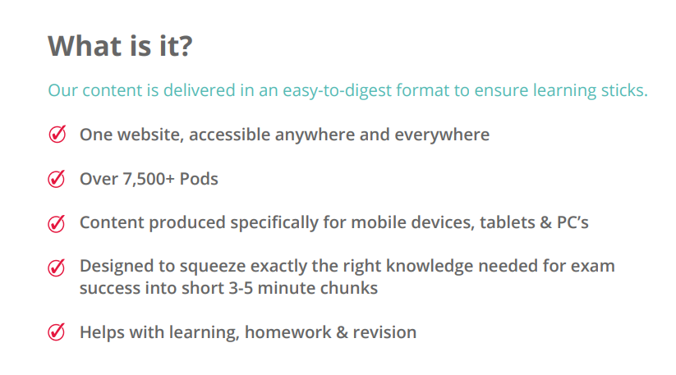



Slide 17
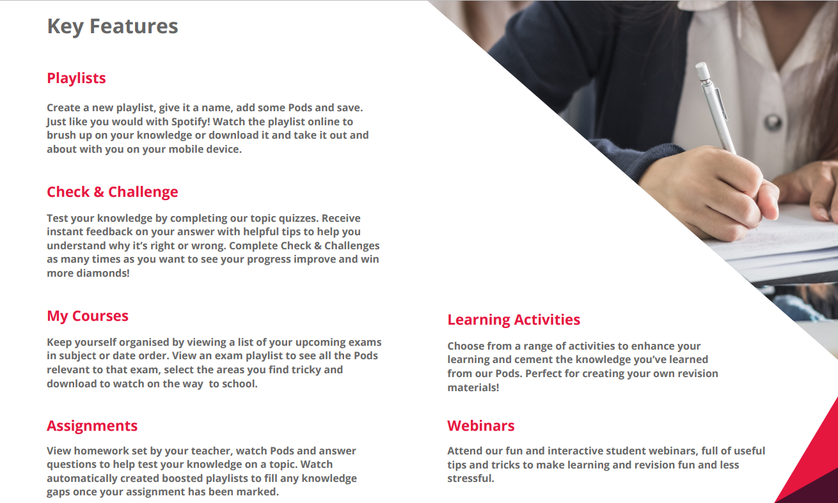
You will have an introductory lesson over the next two weeks in English to get logged in and get to know the site.

Slide 18
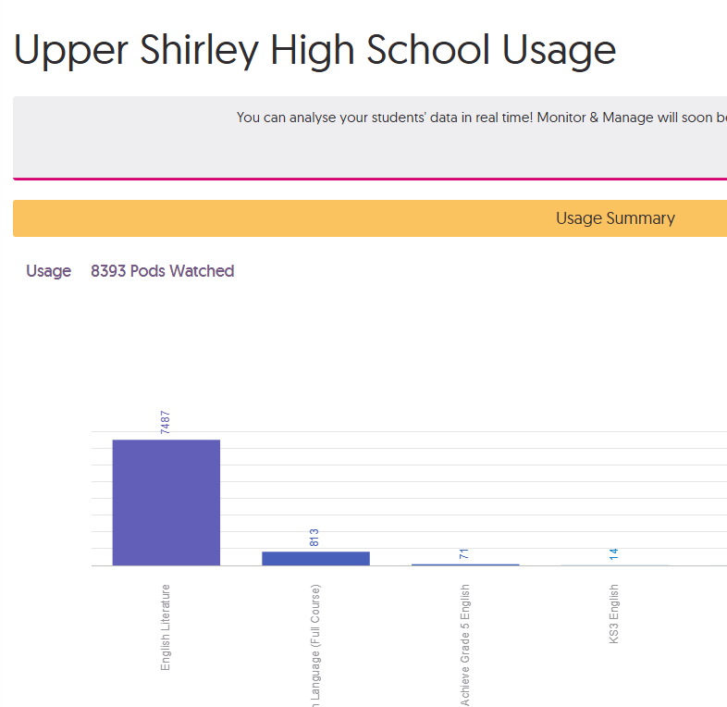
Over 8000 pods watched by USH students since our launch in December!
Notes:
Students have watched more lit pods due to recent lit exam, but remind parents that there are very useful language pods available too.

Slide 19
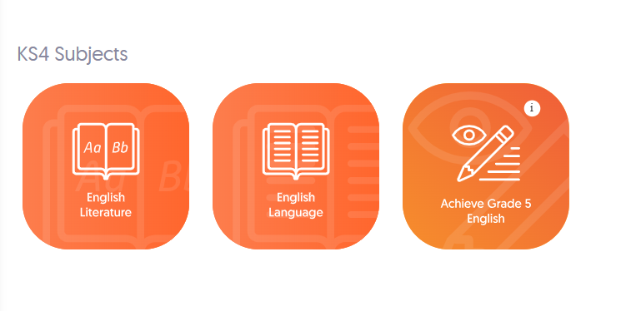
How can I use it to revise?
Log in, and click on the GCSE focus area you want to revise.

Slide 20

How can I use it to revise?
Click on the topic you want to revise.

Slide 21

How can I use it to revise?
In this case, we’ll revise Macbeth, so click on this topic.

Slide 22
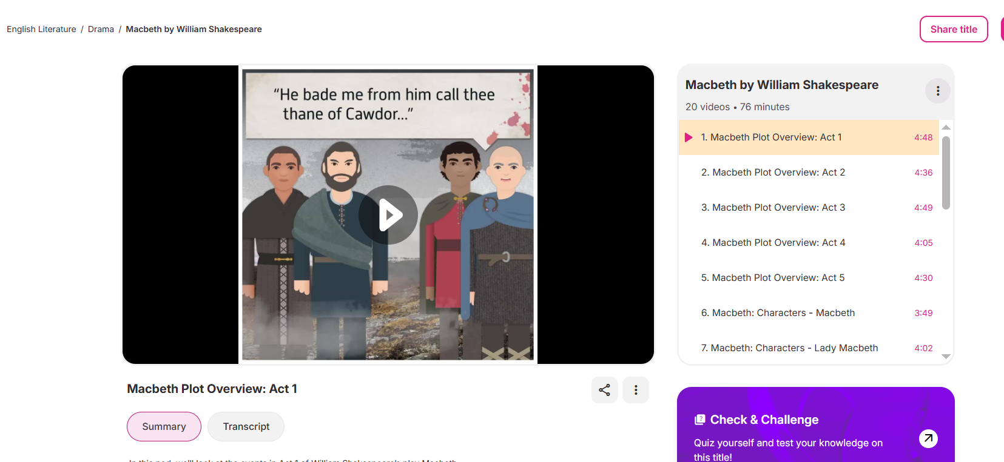
How can I use it to revise?
Pick your pod to watch.

Slide 23

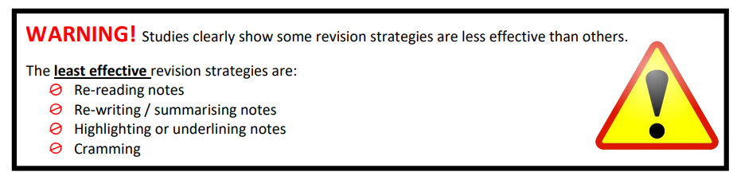
Revision @USH
“you can’t think about something you don’t know”
Didau 2020

Slide 24
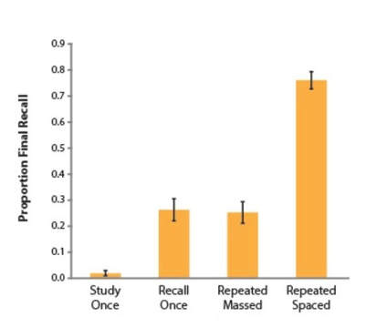
Just like learning styles – there is no 1 size fits all revision method. The aim is to identify a range of strategies and make revision ACTIVE not passive.
Retrieval is the main skill we require from students when they enter examinations – the ability to recall information from memory!
Retrieval practice keeps people focused.
When people attempt to recall or retrieve information, they are actually improving their memory.
In this sense, the brain works like a muscle: recall exercises the brain to strengthen memory.

Slide 25
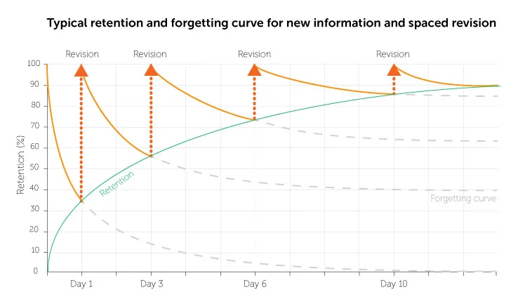
Revise or re-visit?

Slide 26

Revision Timetables

Slide 27
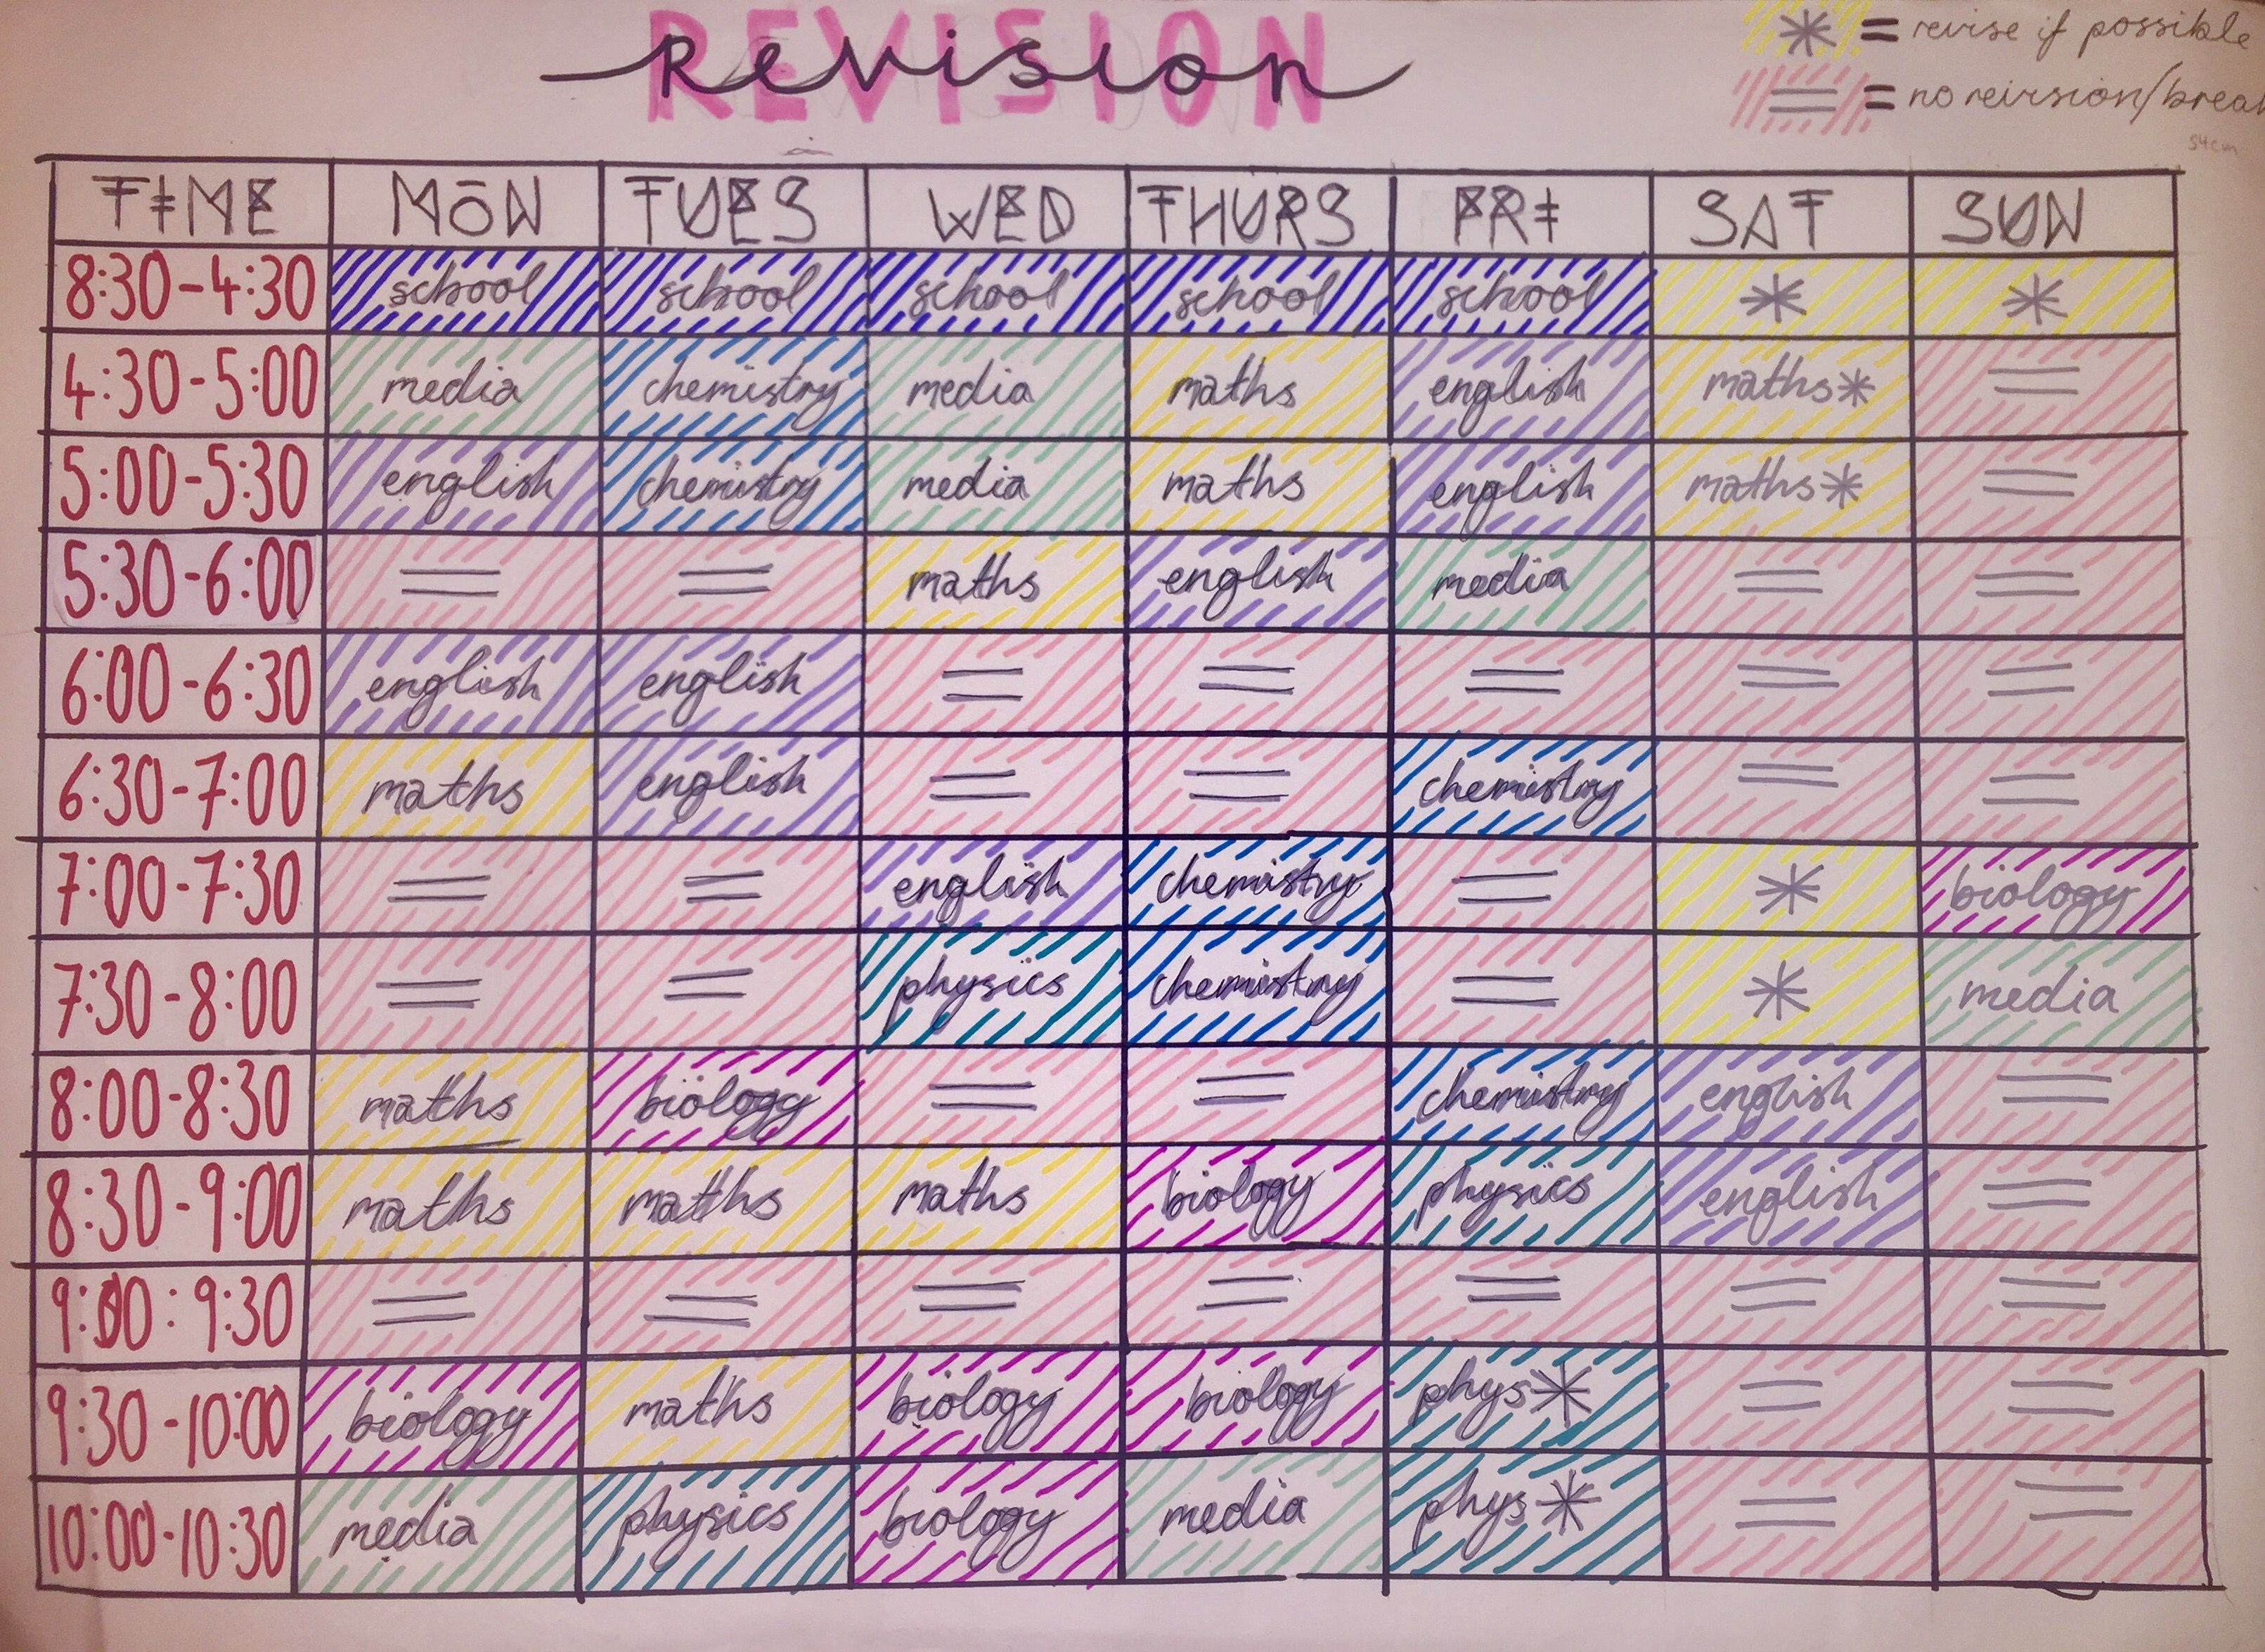
Work out how many revision days you have left until your exams
Decide how much time you will spend revising on each day
​​​Make a list of all the exams you need to revise for
Share the available revision time around each subject and/or exam
Once you've got the basic timetable in place, you can start breaking those subject timings down into topics.

Slide 28
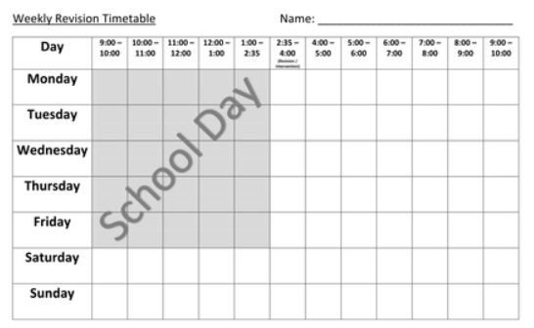

Slide 29
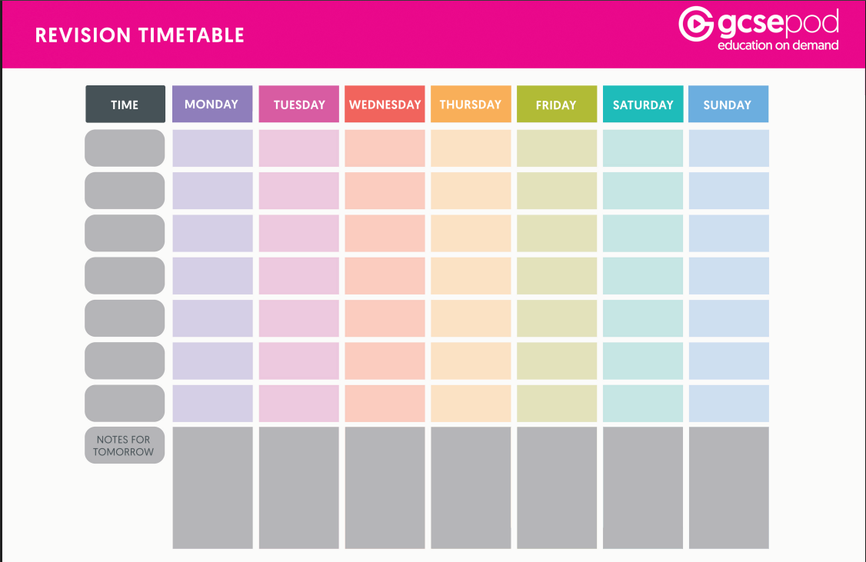

Slide 30


Slide 31
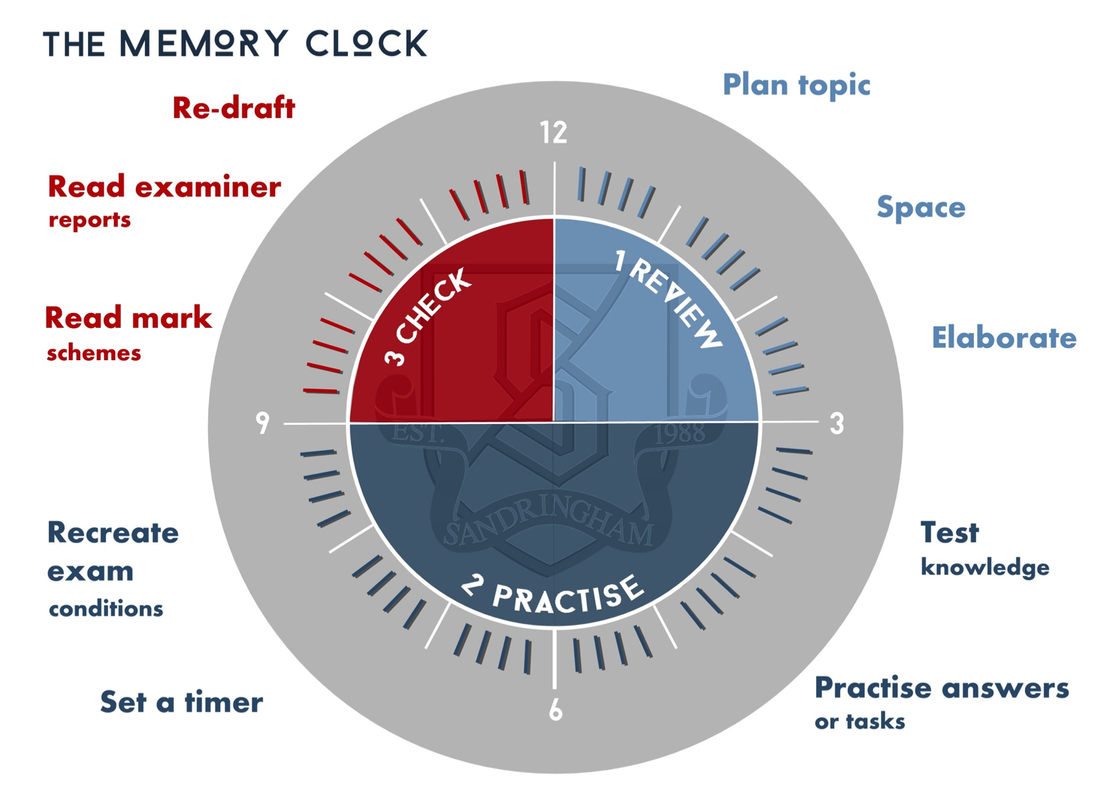

Slide 32


Slide 33

Brain Dumps

Slide 34
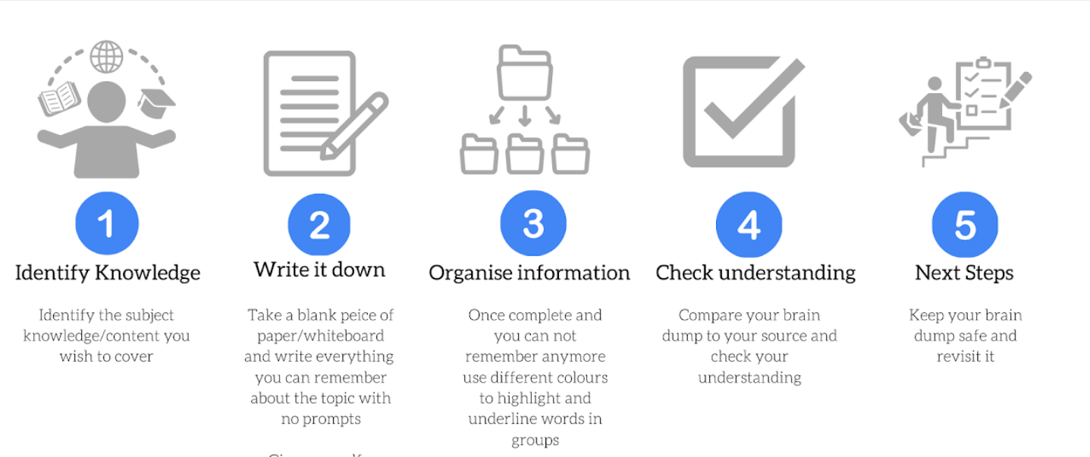

Slide 35
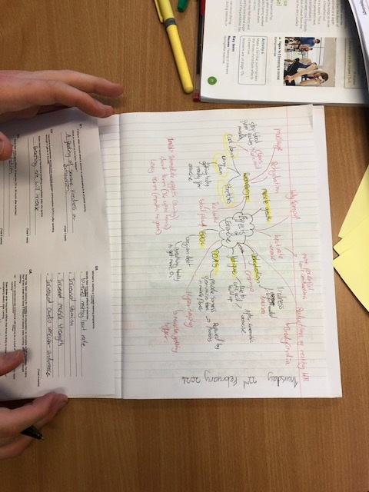
Brain Dumps
Good for…
Identifying which parts of a topic you need to focus on the most.
How it works…
On blank paper write down the topic name as a heading.
Set time limit and write down as much as you can remember.
Read over your class notes/Use revision guide/Text book to gain additional ‘refreshment’ on the topic.
Take a different colour pen and add more information to your page from memory.
✓ Use it to identify what information you struggled to remember so you know what parts of the topic to prioritise for more focused revision.
✓ Use brain dumps as a group revision activity. Swap with your partner, add to your partners brain dump anything they have missed.

Slide 37

Mind maps

Slide 38
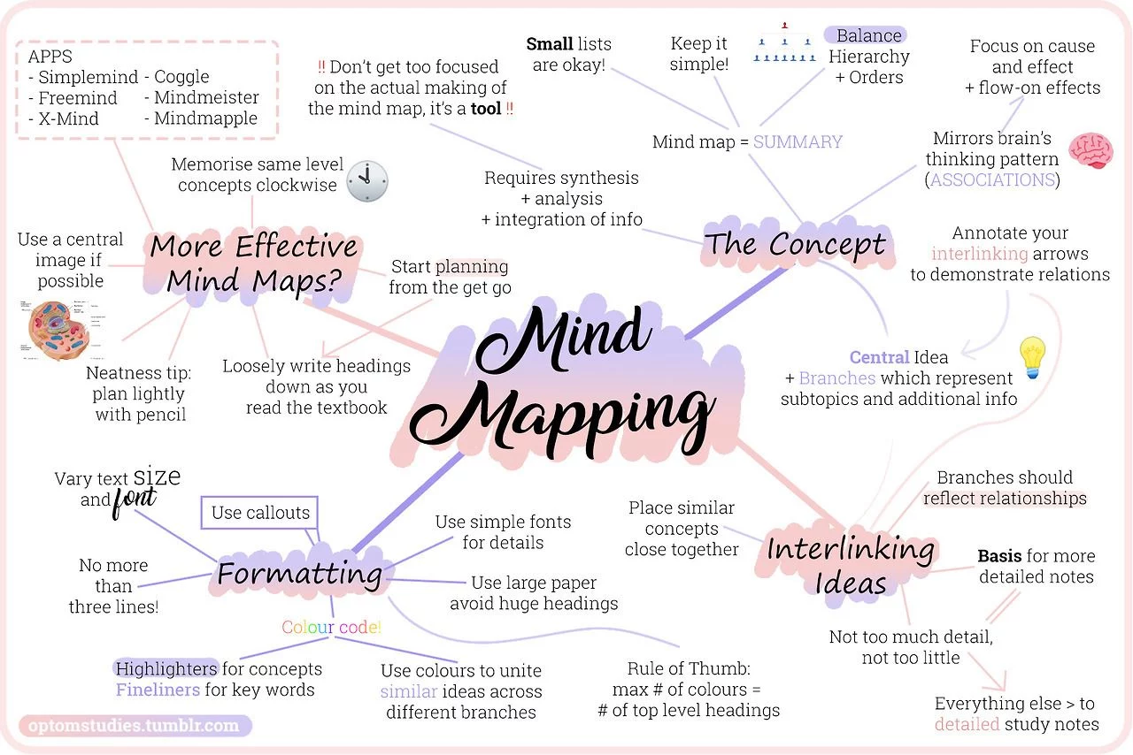
Choose a main theme that you want to revise.
Write the main theme in the centre
Draw branches coming out from the main theme and write main ideas as nodes.
Add additional sub-nodes branches connecting related ideas
Use different colours, symbols, and images to represent different ideas and relationships.
Node
Subnode
Main Theme

Slide 39
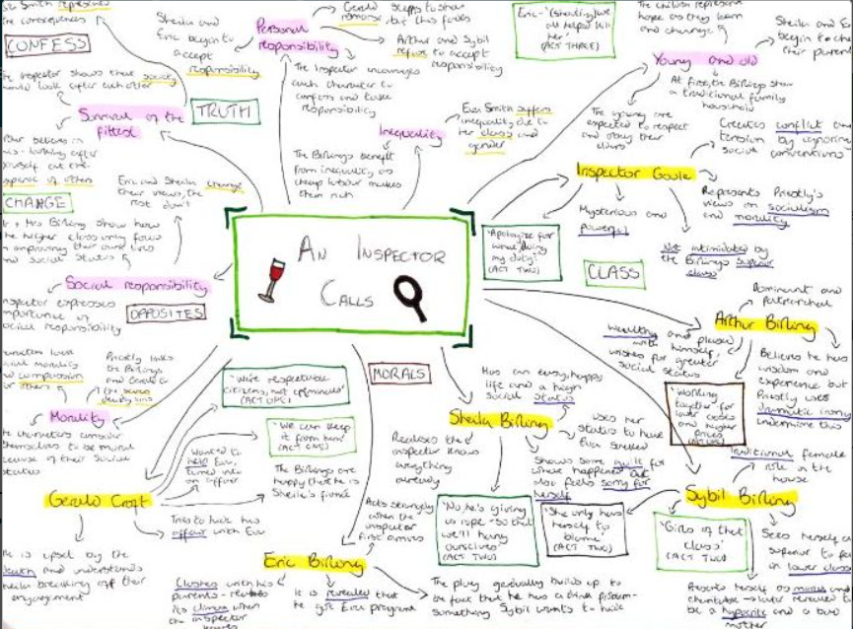
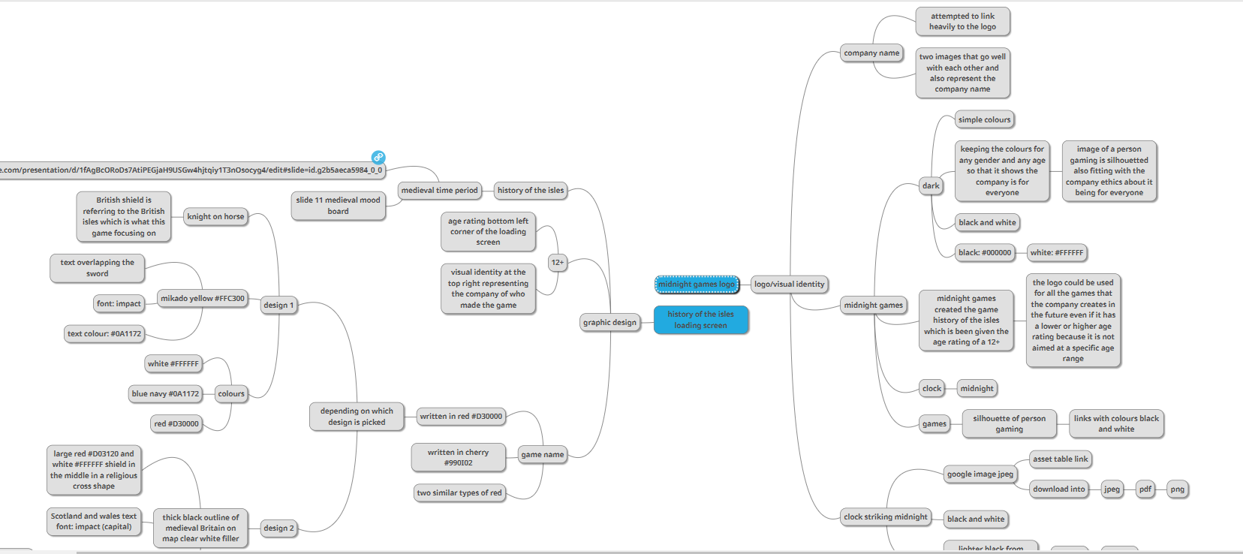
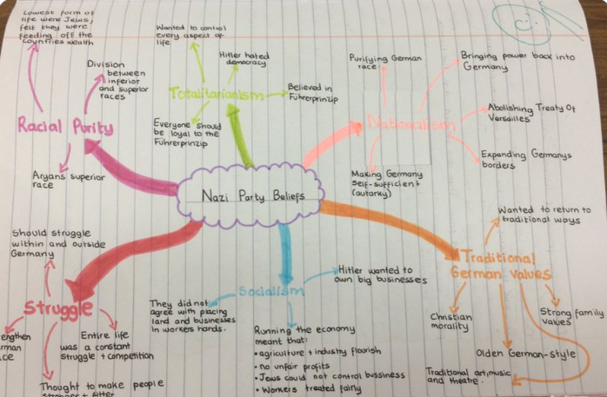
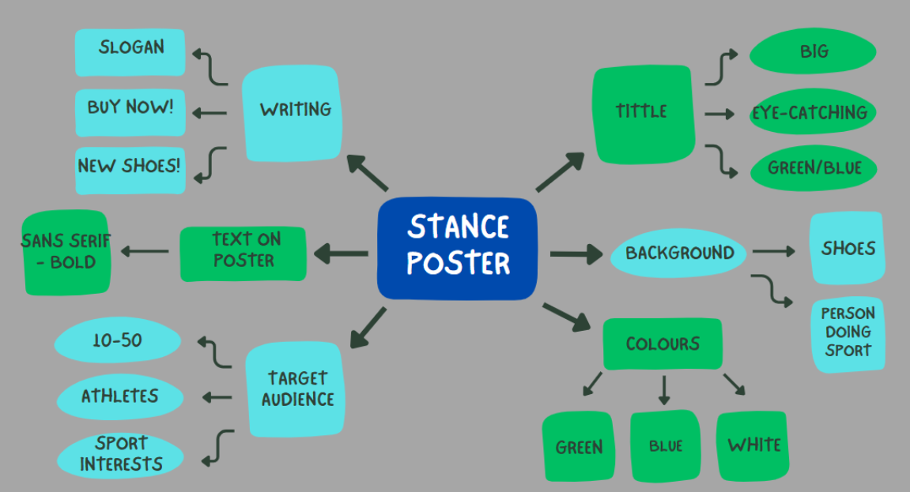
Using websites to generate their mind maps:
Mindmup.com
Canva.com

Slide 40
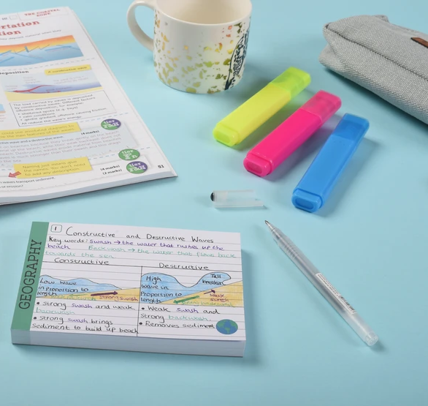
flashcards
They allow you to refine learning - concise and condense.
Actively engage and think
Practicing and learning the same information over and over again helps facts/knowledge stick in your long-term memory.
Use flashcards to test yourself.

Slide 42
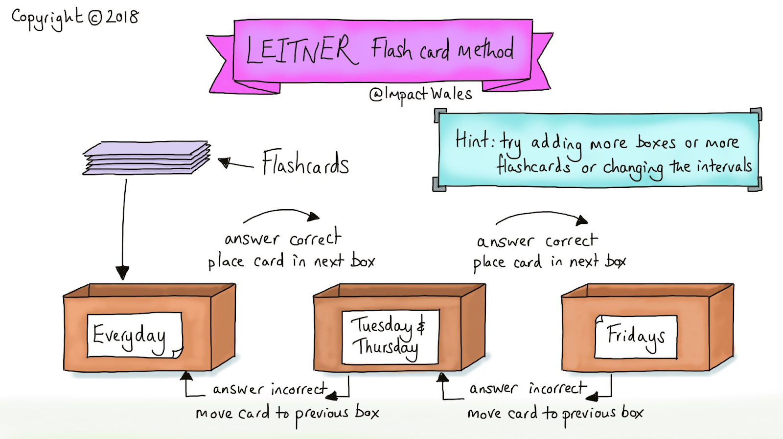

Slide 43
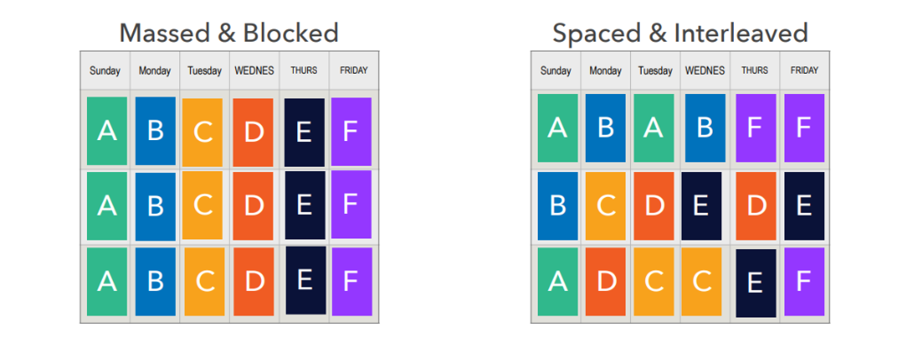
Interleaving and Spaced pratice
Interleaving – mixing the topics.
‘..students switching between topics whilst revising in order to improve their learning. The reason behind this is that it helps students make connections between topics and forces them to think harder about which strategies need to be applied to which problems.’

